Slide 1
CIS 4930-001: Introduction to Augmented and Virtual Reality
Other Senses: Sound, Touch, Smell, and Taste

Slide 2
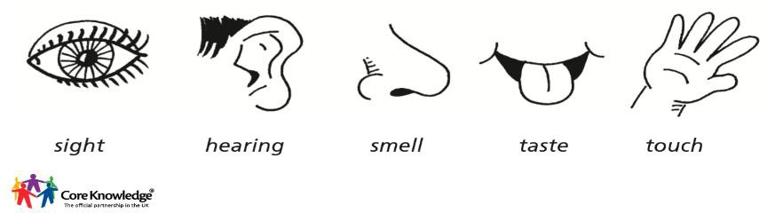
Senses
How an organism obtains information for perception:
Sensation part of Somatic Division of Peripheral Nervous System
Integration and perception requires the Central Nervous System
Five major senses:
Sight (Opthalamoception)
Hearing (Audioception)
Taste (Gustaoception)
Smell (Olfacaoception)
Touch (Tactioception)

Slide 3
Senses
People have tried to address pretty much all the sensory modalities
Are they solvable for the general case?
Are they important?
What is the future of VR?

Slide 4
Sound

Slide 5
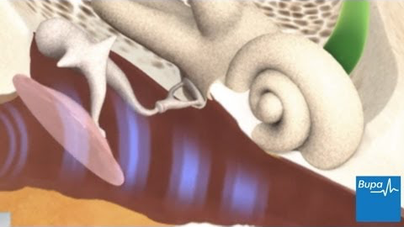
How the ear works
https://youtu.be/-bKy02f1pD4

Slide 6
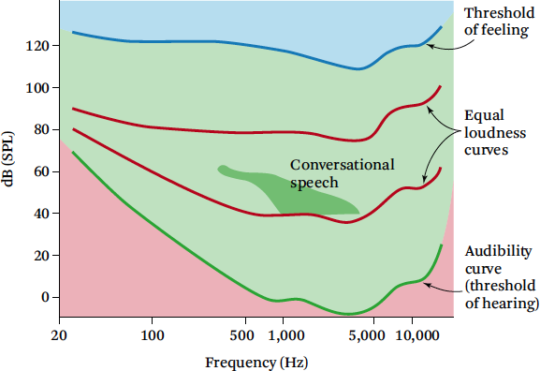
Auditory Thresholds
Humans hear frequencies from 20 – 22,000 Hz
Most everyday sounds from 80 – 90 dB
Lower frequencies more felt by the whole body than heard by the ears

Slide 7
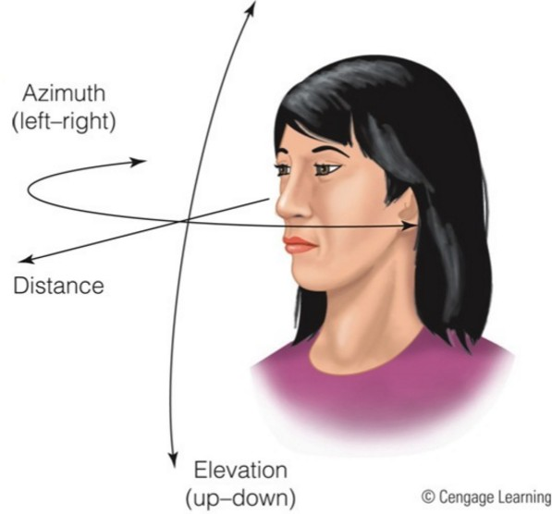
Sound Localization
Humans have two ears to help localize sound in space
Sound can be localized using 3 coordinates
Azimuth, elevation, distance

Slide 8
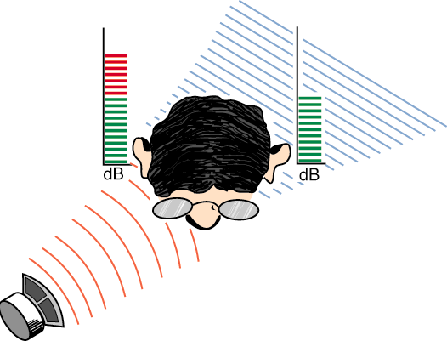
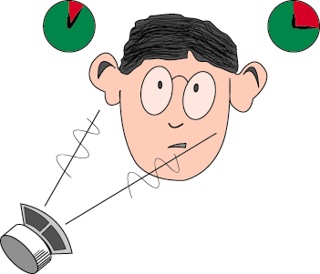
Sound localization
Primary Percepts
Interaural level differences (ILD): sound is louder at the ear that it is closer
Interaural time difference (ITD): the time delay between sounds arriving at the left and right ears
Secondary Percepts
Head shadow: sound having to go through or around the head in order to reach an ear.
Pinna response: the effect that the external ear, or pinna, has on sound.
Shoulder echo: sound in the range of 1-3kHz are reflected from the upper torso of the human body.
Head motion: movement of the head helps in determining a location of a sound source.
Early echo response: occurs in the first 50-100ms of a sounds life.
Reverberation: reflections from surfaces around.

Slide 9
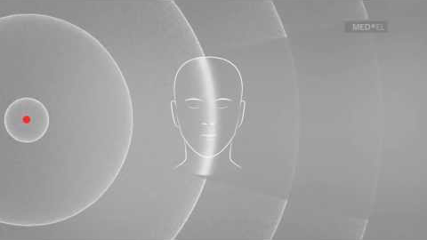
Sound Localization
https://youtu.be/FIU1bNSlbxk

Slide 10
Accuracy of Sound Localization
Sounds can be perceived to have an origin
Most accurately in front of them
2-3° error in front of head
Least accurately to sides and behind head
Up to 20° error to side of head
Largest errors occur above/below elevations and behind head
Front/back confusion is an issue
Up to 10% of sounds presented in the front are perceived coming from behind and vice versa (more in headphones)
BUTEAN, A., Bălan, O., NEGOI, I., Moldoveanu, F., & Moldoveanu, A. (2015). COMPARATIVE RESEARCH ON SOUND LOCALIZATION ACCURACY IN THE FREE-FIELD AND VIRTUAL AUDITORY DISPLAYS. In Conference proceedings of» eLearning and Software for Education «(eLSE)(No. 01, pp. 540-548). Universitatea Nationala de Aparare Carol I.

Slide 11
Sound in VR
Associate sounds with particular events
Associate sounds with static objects
Associate sound with the motion of an object
Use localized sound to attract attention to an object
Use ambient sounds to add to the feeling of immersion
Use speech to communicate with devices or avatars
Use sound as a warning or alarm signal

Slide 12
The need of audio in VR
In Virtual Reality the display has to produce the immersion in a 3D computer generated world. In addition to the visual and tactile displays, audio is needed. In VR:
Sound enhances the presence of the simulation.
It enhances the display of spatial information (particularly space beyond the field of view ). This includes acoustical properties of the environment and the geometrical relationships of the source and listener
Data-driven sound can convey simulated properties of the constituents of the environment. For instance mass, force of impact...
Audio signals provide a higher degree of temporal resolution than visual display.
Audio is also another channel of communication between the user and the environment.
Useful in designing systems where a user monitor several communication channels at once ('cocktail-party effect')

Slide 13
Headphones vs. Speakers
Headphones:
work well with head-coupled visual displays
easier to implement spatialized 3D sound fields
mask real-world noise
greater portability
Private
Speakers:
work well with stationary visual displays
greater user mobility
little encumbrance
multiuser access

Slide 14
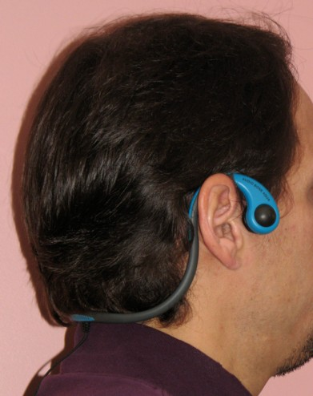
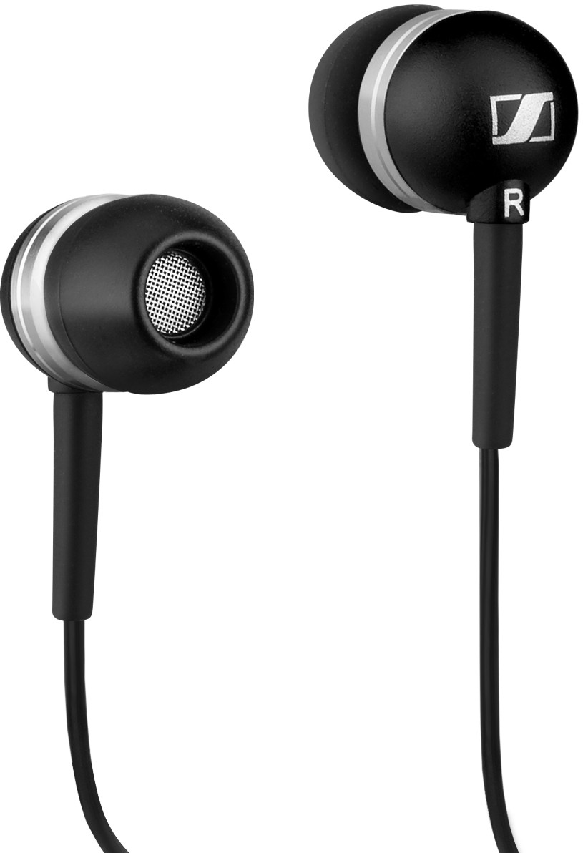
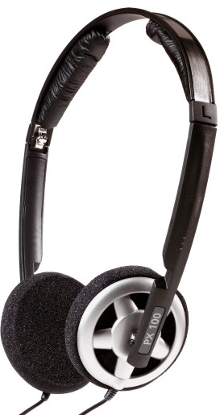
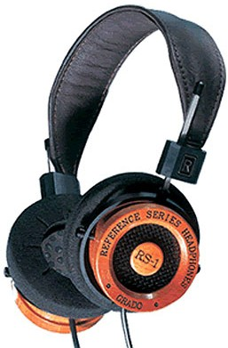
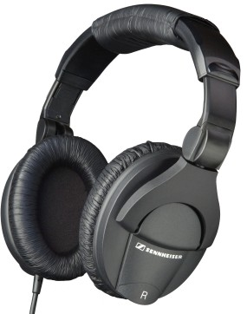
Audio Displays: Head-worn
Ear Buds
On Ear
Open Back
Closed
Bone Conduction

Slide 15
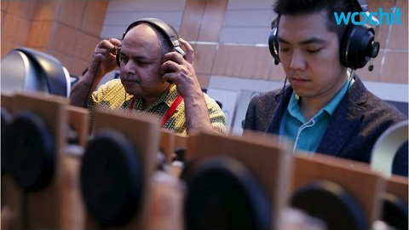
OSSIC Demo
https://youtu.be/WjvofhhzTik

Slide 16
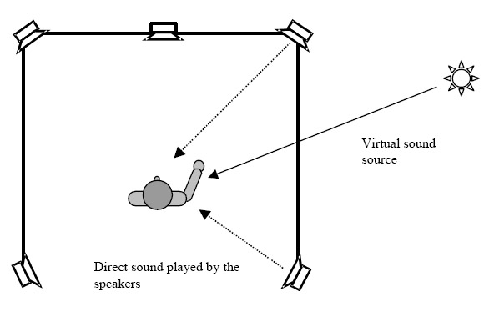
Speaker Configuration
Challenges
Virtual sound sources move relative to speakers
Listener moves relative to speakers
All movements in 3D
Existing movie theater solutions designed for non-moving listener in 'sweet spot' or 'sweet area'; speakers in a plane: 2D sound

Slide 17
Sound Rendering
To generate correct echoes must model sound behavior in the space
Rooms are complex
Filled with different materials
Reflective, Absorbent, Frequency filtering

Slide 18
Auralization or audio in 3D
3D audio is not:
Extended Stereo, where an existing stereo (two channel) soundtrack add spaciousness and make it appear to originate from outside the left/right speaker locations.
Surround sound, where another dimension front/back is added to the stereo.
3D interactive sound system
Sounds are projected in all three dimensions (left/right, up/down, front/back) in real-time

Slide 19
Sound Waves
Generally sound waves propagate in all directions
Propagation affected by interference, reflection, diffraction, refraction -- much like light
Can interact with other media, e.g., can be transmitted from solids into fluids

Slide 20
The Basics of VR Acoustics
In the virtual world we can talk of an auditory world, which reproduced the characteristics of the real, and it is composed by:
The auditory actor: Entity emitting sounds through its interface.
The auditory space: The environment that has to be modeled. Sound is reflected, attenuated, refracted and also diffract around objects. An auditory space object models the geometry of the enclosures in the world.
The listener: They move around and orientate in the world, capable of perceiving the sounds.

Slide 21
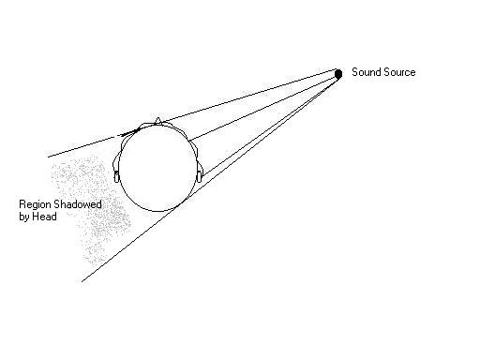
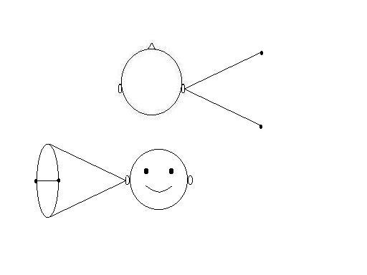
The Listener
Calculating position of sound would be “trivial” if we didn’t have our head blocking one of the ears (or both)
Simple model
Tries to model how sound is perceived using two ears ”mounted” on a solid sphere...
Solving the equations for wave propagation around this rigid sphere
Problematic as
First, ILDs are not linear with frequency
For frequencies > 1500Hz, ITD becomes ambiguous
Cone of Confusion—Multiple positions have identical ILD, ITD

Slide 22
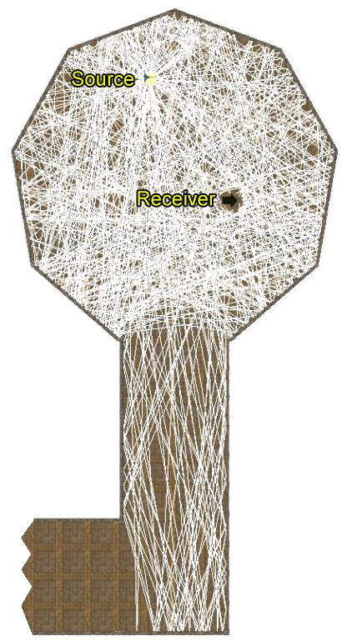
Auditory Space
As sound waves does not only move directly from the source to the listener, it gets colored and diffracted on its way from the source to the listener.
Using GPU for calculating raytracing for sound paths.
Walls are given material properties
Uses purely specular model (no diffraction, refraction, diffusion)
Preprocesses mesh
Remove invalid geometry
Portal calculation
Build BSP
Propagation of rays through portals and reflecting them from walls
Using echogram to generate spatial sound

Slide 23
Auditory Actor
Sound can be sampled or synthetic:
Sampled sounds are digital recordings of a sound that are temporally mapped and played back on demand.
Synthetic sounds are created from arbitrary parameters. Approaches used for generating sounds: Fourier synthesis, signal multiplication, filtering, frequency modulation, timbre trees (in which parameters of motion will determine the parameters of generation)...
Generating sounds is a difficult task.

Slide 24
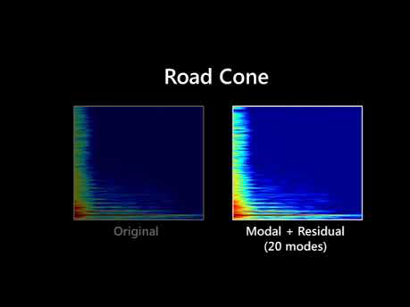
https://youtu.be/eJrb9HSzdXc

Slide 25
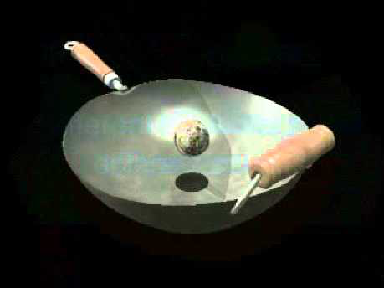
Real-time synthesis of sound-effects
https://youtu.be/jCxXtp_nyno

Slide 26
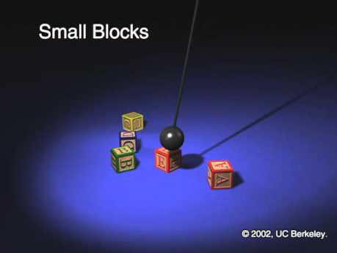
Synthesizing Sound from Rigid-Body simulations
https://youtu.be/-vo84AxF4R4

Slide 27
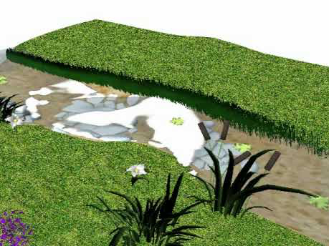
Sounding Liquids: Automatic Sound Synthesis from Fluid Simulation
https://youtu.be/MHBViinfmKo

Slide 28
Audio-Visual Synergy
Together, synchronized 3D audio and 3D visual cues provide a very strong immersion experience.
3D audio removes a lot of requirements on the visual part
The graphics don’t have to be as nice!
It is needed a single framework that integrates arbitrary sounds and motions for virtual environments. This is done when audio parameters are taken from motion parameters, and motion and audio are synchronized.
Head Movement and Audio
Audio cues change dramatically when a listener tilts or rotates his head. The ears alert the brain about an event outside of the area that the eyes are currently focused on, and we automatically turn to redirect our attention.
Interactive audio is much better than prerecorded audio because it allows the listeners head motion be properly simulated.

Slide 29
Touch

Slide 30
Touch
Actually a range of skin senses
touch / pressure
hot / cold
pain
Useful for object identification & understanding

Slide 31
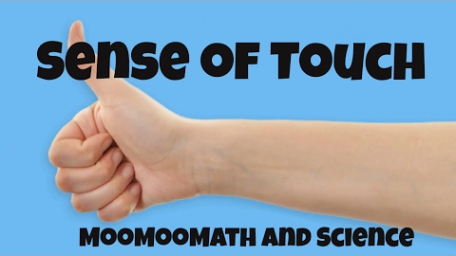
How touch works
https://youtu.be/auzDA_-YXRw

Slide 32
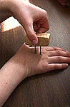
Spatial Resolution
Sensitivity varies greatly
Two-point discrimination
Body Site | Threshold Distance
Finger | 2-3mm
Cheek | 6mm
Nose | 7mm
Palm | 10mm
Forehead | 15mm
Foot | 20mm
Belly | 30mm
Forearm | 35mm
Upper Arm | 39mm
Back | 39mm
Shoulder | 41mm
Thigh | 42mm
Calf | 45mm
http://faculty.washington.edu/chudler/chsense.html

Slide 33

Proprioception/Kinaesthesia
Proprioception (joint position sense)
Awareness of movement and positions of body parts
Due to nerve endings and Pacinian and Ruffini corpuscles at joints
Enables us to touch nose with eyes closed
Joints closer to body more accurately sensed
Users know hand position accurate to 8cm without looking at them
Kinaesthesia (joint movement sense)
Sensing muscle contraction or stretching
Cutaneous mechanoreceptors measuring skin stretching
Helps with force sensation

Slide 34
Touch
Uses
Medicine
Virtual Prototyping
General UI enhancement

Slide 35
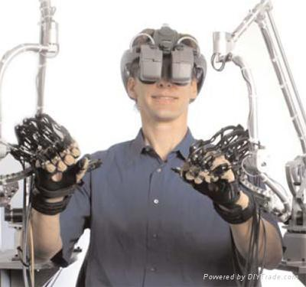
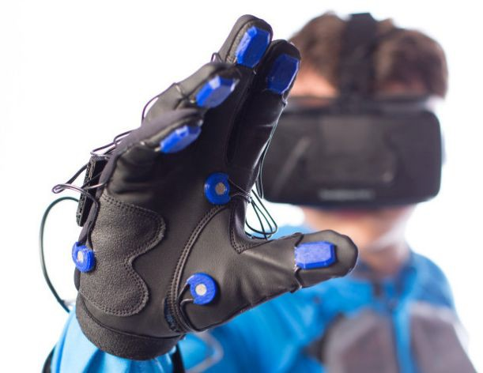
Haptic Feedback
Greatly improves realism
Hands and wrist are most important
High density of touch receptors
Two kinds of feedback:
Touch Feedback
information on texture, temperature, etc.
Does not resist user contact
Force Feedback
information on weight, and inertia.
Actively resists contact motion

Slide 36
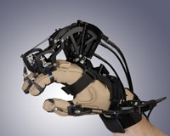

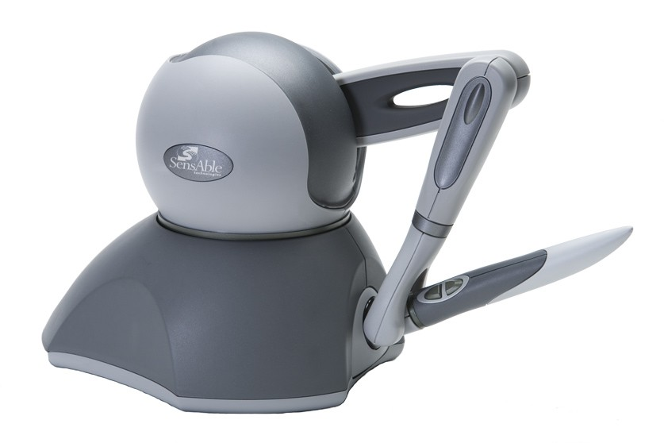

Active Haptics
Actively resists motion
Key properties
Force resistance
Frequency Response
Degrees of Freedom
Latency

Slide 37
Tactile Feedback Interfaces
Goal: Stimulate skin tactile receptors
Using different technologies
Air bellows
Jets
Actuators (commercial)
Micropin arrays
Electrical (research)
Neuromuscular stimulations (research)

Slide 38
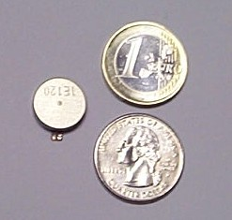
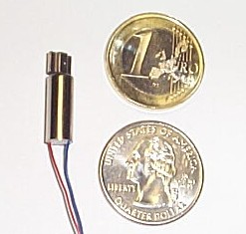
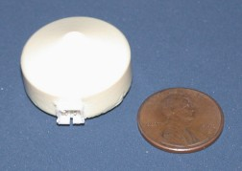
Vibrotactile Cueing Devices
Vibrotactile feedback has been incorporated into many devices
Can we use this technology to provide scalable, wearable touch cues?

Slide 39
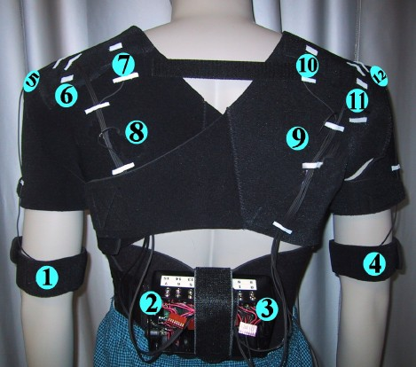
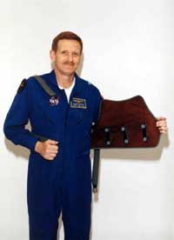
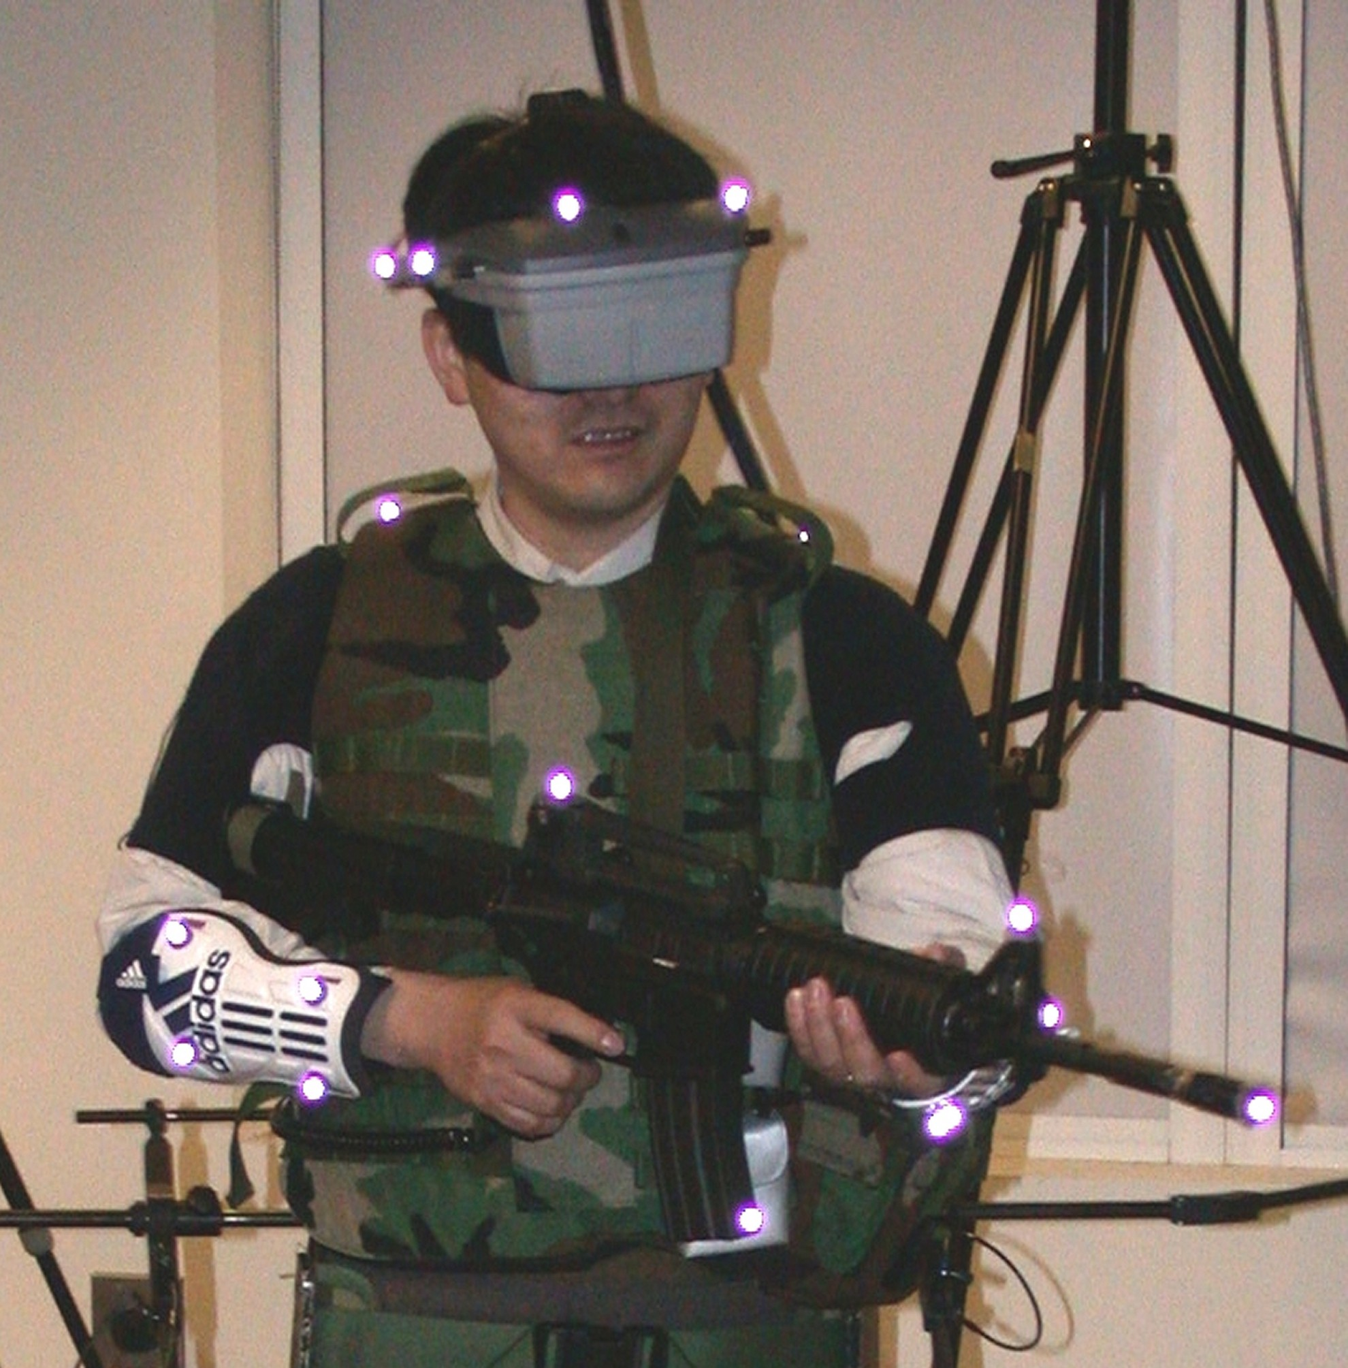
Vibrotactile Feedback Projects
TactaBoard and TactaVest
Navy TSAS Project

Slide 40
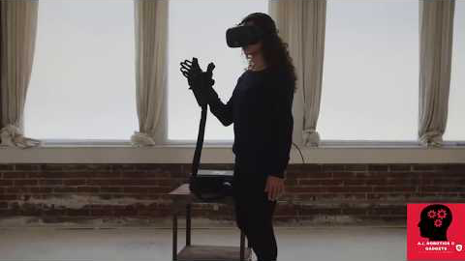
Example: HaptX Glove
https://youtu.be/4K-MLVqD1_A

Slide 41
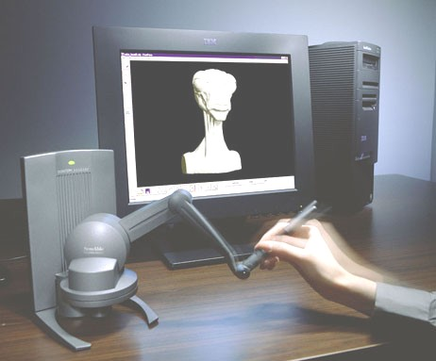
Example: Phantom Omni
Combined stylus input/haptic output
6 DOF haptic feedback

Slide 42
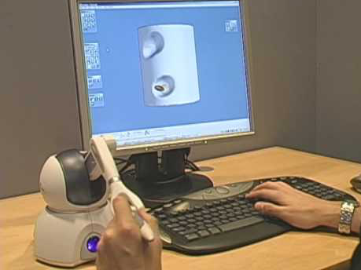
Phantom Omni Demo
https://youtu.be/REA97hRX0WQ

Slide 43
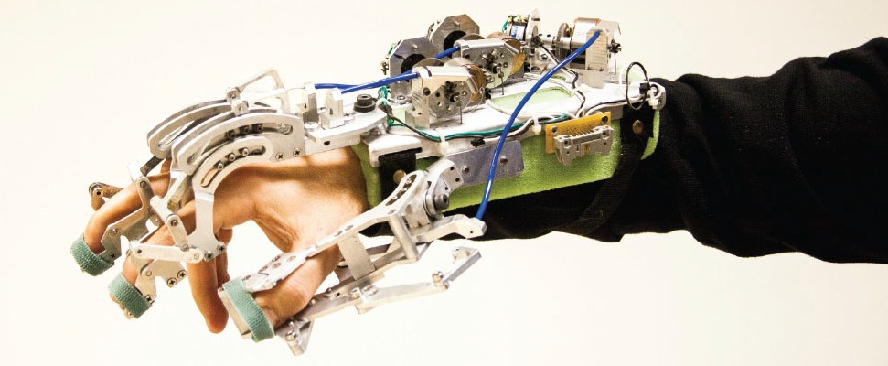
Haptic Glove
Many examples of haptic gloves
Typically use mechanical device to provide haptic feedback

Slide 44
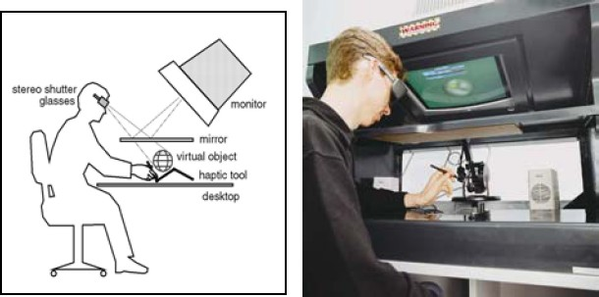
Haptic Input
AR Haptic Workbench
CSIRO 2003 – Adcock et. al.

Slide 45
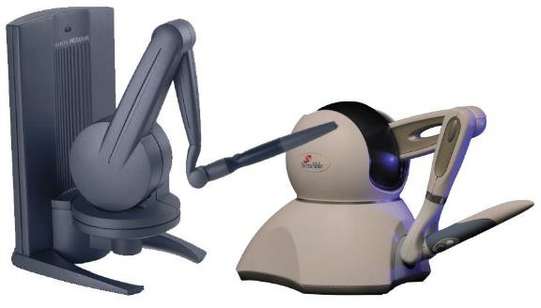
Phantom
Sensable Technologies (www.sensable.com)
6 DOF Force Feedback Device

Slide 46
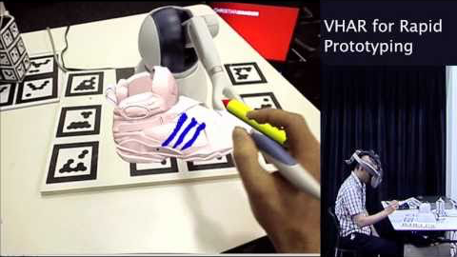
Example: Haptic Augmented Reality
https://youtu.be/3meAlle8kZs

Slide 47
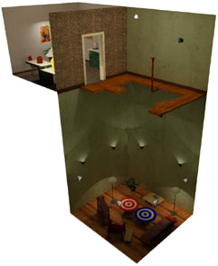
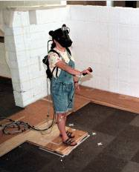
Passive Haptics
Not controlled by system
Use real props
Pros
Cheap
Large scale
Accurate
Cons
Not dynamic
Limited use

Slide 48
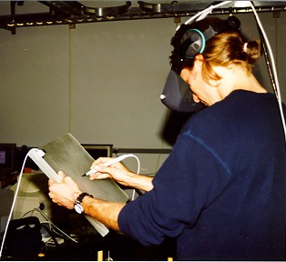
Near-field (passive) haptics
Use of props - “poor man’s” haptic display
Grounding in VE
Examples:
pen & tablet
GM: plastic cup
hairy spider
airplane cockpit

Slide 49
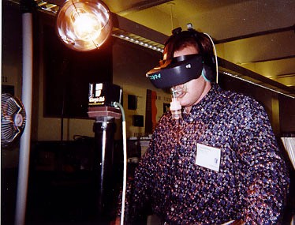
Displaying to other skin senses
Simple, special-purpose “displays” for temperature, air movement, etc.
Fan
Heat lamp

Slide 50
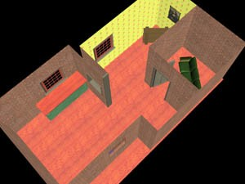
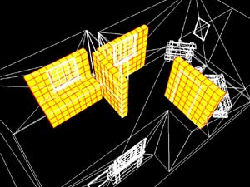
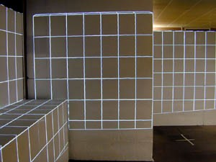
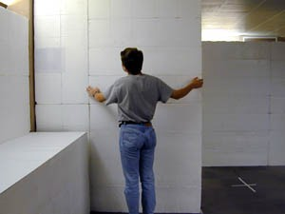
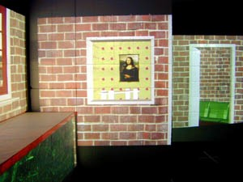
UNC Being There Project

Slide 51
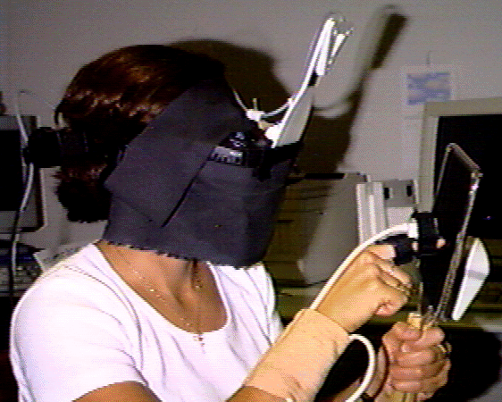

Passive Haptic Paddle
Using physical props to provide haptic feedback
http://www.cs.wpi.edu/~gogo/hive/

Slide 52
Large format displays
There are many large physical displays that help provide realism
Think aircraft simulator containing real looking aircraft controls

Slide 53

The Virtual Palpitator
Simulate touch of bovine reproductive system
Addresses these issues (from Virtalis website)
difficult to guide students when the instructor can’t see what they are palpating inside the cow/horse.
students can’t see what the instructor is doing, so can’t copy.
little quality feedback from "the patient"
concerns for animal welfare

Slide 54


Shape Displays
Combine tactile and force feedback
Project FEELEX
https://youtu.be/EOl7n0sqs14?t=14

Slide 55


A cool DARPA project
Dynamic sand table
https://youtu.be/AxJmFj7nbMA?t=15

Slide 56
Smell

Slide 57

How the Nose Works
https://youtu.be/zaHR2MAxywg

Slide 58
Olfactory Mechanisms
Air with molecules pass by olfactory nerve endings
How to increase smell throughput?
How many smells are there?
Can distinguish around 10,000 smells
Maybe around 400K smells out there
Numbers provide an analogue to true color visual at 16M colors
But how many basis functions?
Olfactory Interfaces
Increased immersion
Task-specific information (e.g., Fire-fighting)

Slide 59
Smell Classification
Basic units of smell are caprylic, fragrant, acid, and burnt (Cater, 1992). Other terms that have been used are fruity, spicy, floral, and green.
Six category prism (Henning 1915)
Perfumery (Curtis and Williams 1994)
set of three letter codes, often trade-secret
Domain specific
beer, wine, and spirits

Slide 60
Perceptual Limits
10 degrees in the horizontal plane, as well as having a field of smell subtending about 130 degrees
Von Bekesy 1964
concentration range sensitivity spanning three orders of magnitude
Dravnieks 1975
Without cues from the other senses subjects in a study failed for two out of three odors to make the correct identification
Zellner, Bartoli, and Eckhard 1991; Youngblut et al. 1996
It is not uncommon to have a high rate of false detection and report the existence of smells that in fact are not present
Richardson and Zucco 1989; Barfield and Danas 1995

Slide 61
Storage Media
Liquid, gel or waxy solids
Microencapsulate odorants
Scratch and sniff
Drops of liquids encapsulated in gelatin

Slide 62

Olfactory Displays
DIVEpak
Computer controlled scratch and sniff
iSmell DigiScents (bankrupt)
smell index (100-200 smells)
TriSenx (bankrupt)
single smell controlled by serial port
Smell-o-Vision (K Opticom)
6 gels, USB controlled

Slide 63



OSS, Fragrance Technology
Fire Trainer
Odors range from burning wood, grease and rubber to sulfur, oil and diesel exhaust.
Air Force + 5,Inc.

Slide 64

Okado Laboratory – Olfactory system
https://youtu.be/p7FEf03OraQ

Slide 65


Smell Cannon
Track target with camera
Aim below eyes
Prerecorded smells

Slide 66
Olfactory Displays
Challenges
clean air input
evacuate air
clean output air
How to control breathing space
sealed room with air filtration
air control in front of and behind user
sealed pod
tethered mask
tubes into an HMD from pack
built into HMD

Slide 67
Taste

Slide 68

Sense of Taste
https://youtu.be/FSHGucgnvLU

Slide 69

Basics of Taste
Sensation produced when a substance in the mouth reacts chemically with taste receptor cells
Taste receptors mostly on taste buds on the tongue
2,000 – 5,000 taste buds on tongues/100+ receptors each
Five basic tastes:
sweetness, sourness, saltiness, bitterness, and umami
Flavor influenced by other senses
smell, texture, temperature, “coolness”, “hotness”

Slide 70

Taste Trivia

Slide 71

Gustatory Displays
Simulate the experience of eating
Iwata food simulator
Capture forces of eating
Playback
Combine flavors
five basic taste sensations: sweet, sour, bitter, salty and umami

